Slide 1
AWS Cloud Fundamentals
Kerry Nakayama

Slide 2
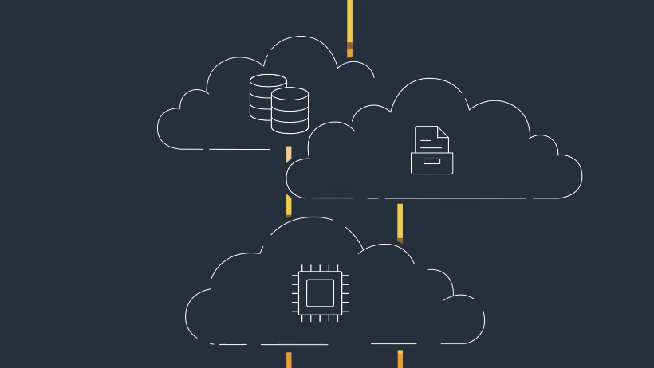
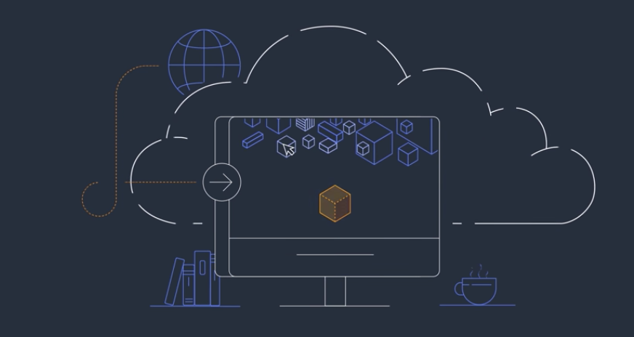
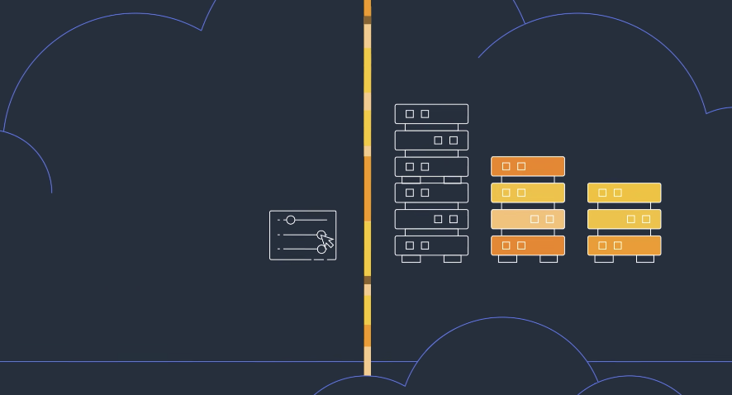
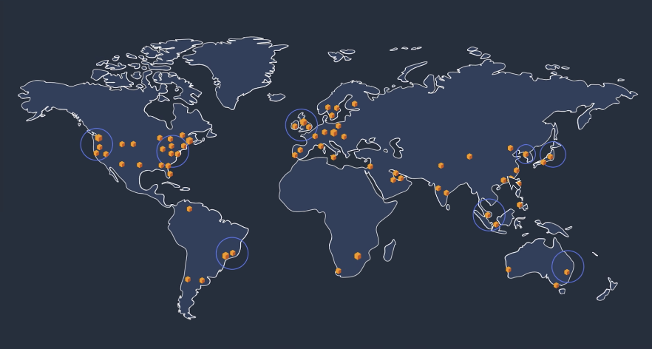
What is Cloud Computing
Cloud computing is the on-demand delivery of IT resources over the Internet with pay-as-you-go pricing
No need for physical data centers or servers
Access on an as-needed basis
Notes:
Basically someone else deals with the data centers and servers
You pay a subscription service fee rather then the cost of ownership - since data is ever changing
Benefits – Agility, Elasticity, Cost saving (use as you need), deploy internationally (servers all over the world reduce latency)
Infrastructure as a service – networking features , computers and data storage space
Platform as a service - removes managing underlying infrastructure
Software as a service – product that is run and managed by service provider
Snowflake

Slide 3
AWS Regions
AWS serves over a million active customers in more than 190 countries
An AWS Region is a physical location in the world where AWS has multiple Availability Zones
AWS provides you with the flexibility to place instances and store data within multiple geographic regions
Notes:
Each Amazon Region is designed to be completely isolated from the other Amazon Regions. This achieves the greatest possible fault tolerance and stability
Each Availability Zone is designed as an independent failure zone. This means that Availability Zones are physically separated within a typical metropolitan region and are located in lower risk flood plains (specific flood zone categorization varies by AWS Region)
In addition to discrete uninterruptable power supply (UPS) and onsite backup generation facilities, they are each fed via different grids from independent utilities to further reduce single points of failure. Availability Zones are all redundantly connected to multiple tier-1 transit providers

Slide 4
IAM User and Roles
You can use AWS Identity and Access Management (IAM) roles to grant access to databases among other items
An IAM role is an IAM identity that you can create in your account that has specific permissions but can be assigned to multiple people
You generally have two ways to use a role: interactively in the IAM console, or programmatically with the AWS CLI
complex uses of roles, such as granting access to applications and services, or federated external users, you can call the AssumeRole API
Notes:
IAM users in your account using the IAM console can switch to a role to temporarily use the permissions of the role in the console. The users give up their original permissions and take on the permissions assigned to the role. When the users exit the role, their original permissions are restored.
An application or a service offered by AWS (like Amazon EC2) can assume a role by requesting temporary security credentials for a role with which to make programmatic requests to AWS. You use a role this way so that you don't have to share or maintain long-term security credentials (for example, by creating an IAM user) for each entity that requires access to a resource.
Federated users sign in by using credentials from an identity provider (IdP). AWS then provides temporary credentials to the trusted IdP to pass on to the user for including in subsequent AWS resource requests. Those credentials provide the permissions granted to the assigned role.

Slide 5
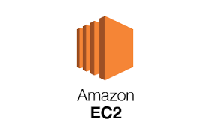
Creating and Managing Virtual Machines with EC2
Amazon Elastic Compute Cloud (Amazon EC2) provides scalable computing capacity in the Amazon Web Services (AWS) cloud
EC2 eliminates your need to invest in hardware up front
Launches instances which are virtual computing environments
Storage volumes for temp data that's deleted when you terminate your instance
known as instance store volumes
Persistent storage volumes for data using Amazon Elastic Block Store (Amazon EBS)
Virtual networks you can create that are logically isolated from the rest of the AWS cloud, and that you can optionally connect to your own network, known as virtual private clouds (VPCs)
Notes:
• Preconfigured templates for your instances, known as Amazon Machine Images (AMIs), that package the bits you need for your server (including the operating system and additional software)
• Various configurations of CPU, memory, storage, and networking capacity for your instances, known as instance types
• Secure login information for your instances using key pairs (AWS stores the public key, and you store the private key in a secure place)
• Multiple physical locations for your resources, such as instances and Amazon EBS volumes, known as Regions and Availability Zones
• A firewall that enables you to specify the protocols, ports, and source IP ranges that can reach your instances using security groups
• Static IPv4 addresses for dynamic cloud computing, known as Elastic IP addresses

Slide 6
Provisions

Slide 7
Networking (Virtual Private Cloud)

Slide 8
Server vs Serverless Architecture
Server | Serverless
Predictive tasks: For tasks that use constant or predictive compute, it may be more cost-effective to use server-based billing | Server management: Because there is no backend infrastructure to be responsible for, liability is reduced and there is no system administration
Testing and debugging: Debugging is less complicated because there is visibility into backend processes and the application is not broken up into separate, smaller functions | Scalability: With a serverless architecture, you don’t have to think twice about provisioning infrastructure because of its ability to automatically scale with traffic volumes
Overall control: The company owns and manages the infrastructure, which provides full control over all aspects of the application | Application flexibility: You can migrate individual application features or partial workloads to run on serverless as on-demand events
Compliance and security: Having full control over the infrastructure allows for full visibility, which may be required for compliance and security standards | Cost: The cost of hiring backend infrastructure engineers goes down, along with operational costs
Legacy applications: Existing applications may not have the flexibility of decoupling individual parts and may be better suited to migrate to a server-based architecture | Startup friendly: The serverless architecture pay-as-you-go model allows you to build an environment nearly for free and ease into the market without dealing with huge bills for minimum traffic

Slide 9
Storage

Slide 10
Cloud Storage System

Slide 11
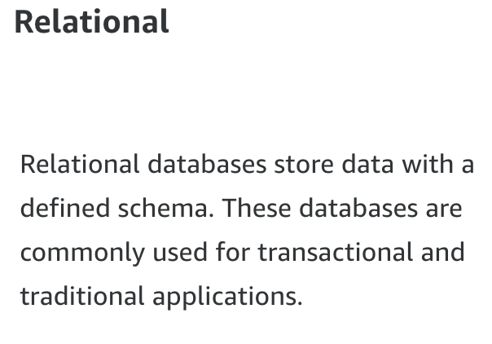
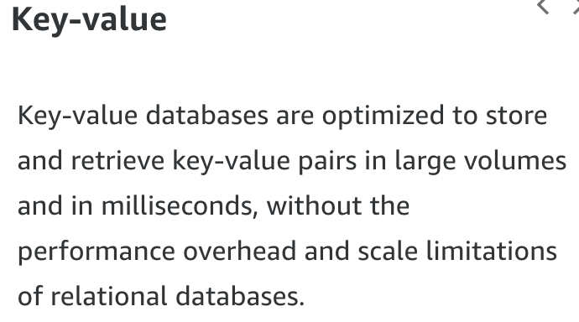
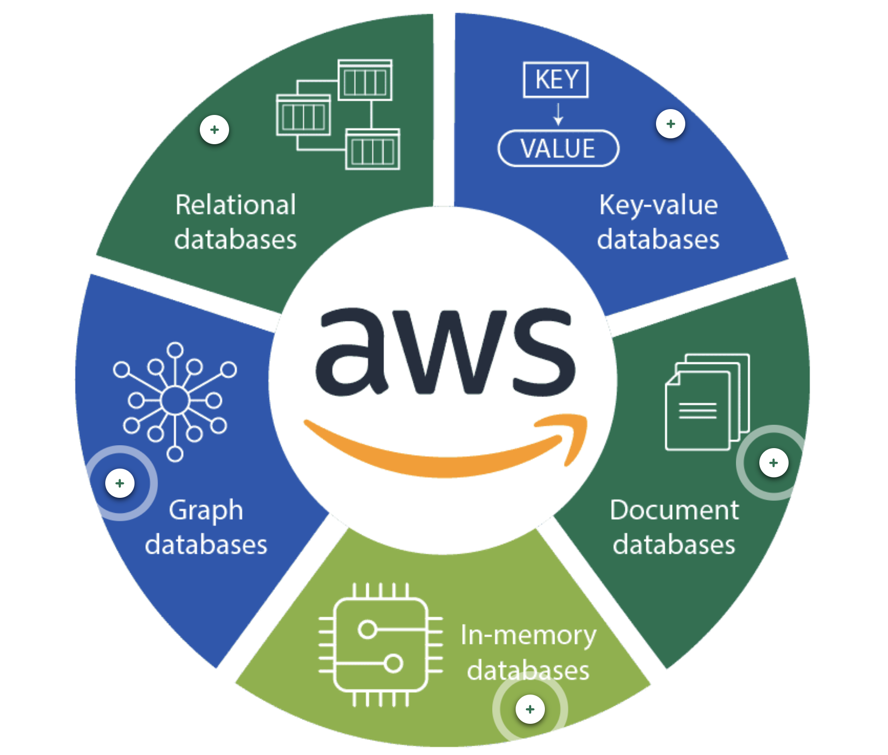
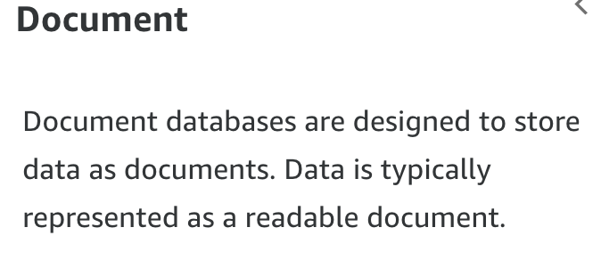
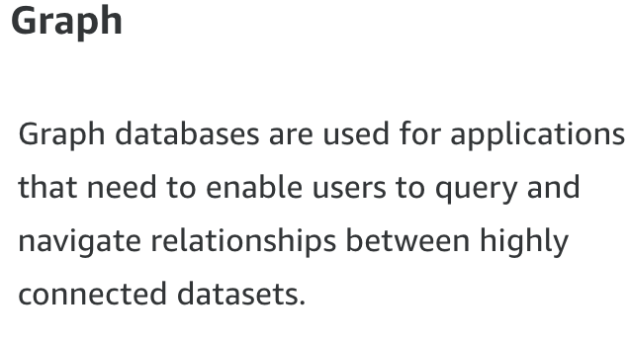
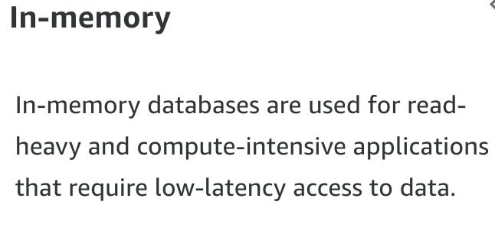
Type of Databases
Notes:
Relational - Aurora – mysql and postgres SQL – use this along with an EC2 instance to ramp up the ability if is slows with huge data sets
KVP – Dynamo DB
Document think mongo DB
Wide Column – High scale industrial apps for equipment maintenance, fleet management, and route optimization
Time series - IoT applications develops and industrial telemetry
Ledger – Systems for record , supply chain, registration, banking transactions

Slide 12

SQL Solutions
Athena – interactive Query service that makes is easy to analyze data directly from Amazon Simple Storage Service (S3 Bucket) with standard SQL. Charges by the number of queries run.
- MPP that allows you to keep the compute and storage separate, while also controlling the cloud services layer.
Redshift – Like Snowflake it too has on-demand pricing. Redshift bundles the compute and storage pricing together and only charging once usage exceeds the allotted seconds. The largest differences are the pricing structures.
BigQuery - Google’s version of the Cloud data warehouse. Again the pricing structure differs with storage being cheaper at a per terabyte than other DWHs.
Notes:
May need to set up Amazon Glue to set up a crawler depending on the format of the data and how it is stored
Athena helps you analyze unstructured, semi-structured, and structured data stored in Amazon S3
Athena integrates with Amazon QuickSight for easy data visualization

Slide 13
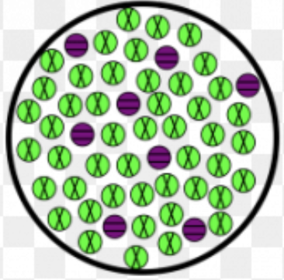
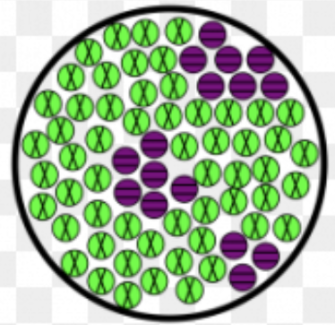
Moving Data in the Cloud
Homogeneous migrations, where you migrate between same database engines, may require the use of native database tools to migrate database elements
Heterogenous migrations, where you migrate between different database engines, require the use of the Schema Conversion Tool to first translate your database schema to the new platform
Notes:
Identifies the issues, limitations, and actions for the schema conversion
Generates the target schema scripts, including foreign keys and constraints
Converts code such as procedures and views from source to target and applies the code on the target.

Slide 14
Transforming Data

Slide 15
Managing Infrastructure (Terraform)

Slide 16
Traditional vs Cloud Data Warehousing

Slide 17

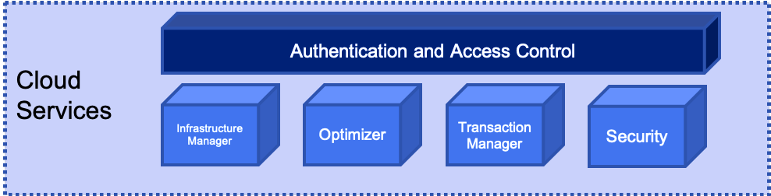
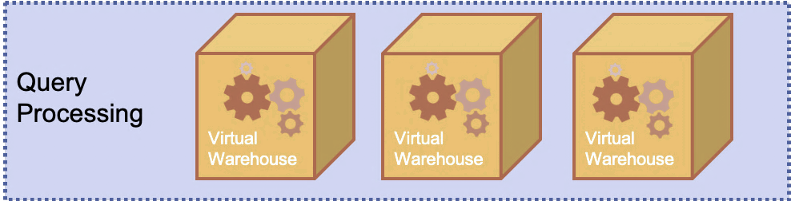
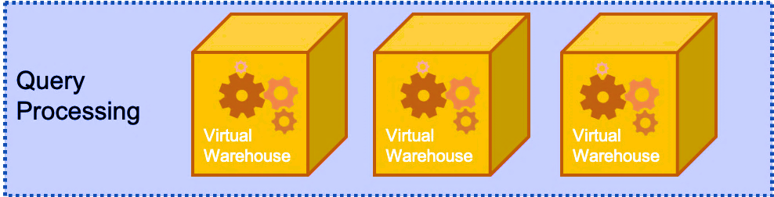
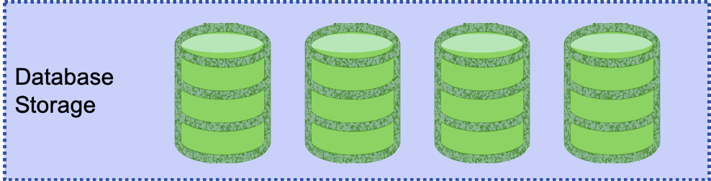
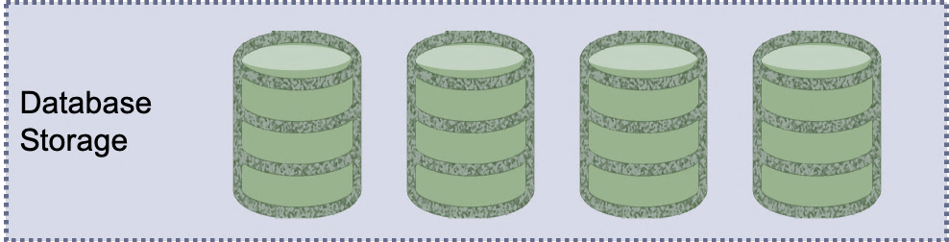
Snowflake is a hybrid of Shared Nothing and Disk
So how does Snowflake address these shortcomings?
Snowflake is Elastic!
Notes:
The idea here is that by using the cloud based infrastructure SNOWFLAKE can essentially throw resources at the management of shared-nothing infrastructure indefinitely.
This is because Snowflake is elastic in nature- it will expand as resources are required and contract when not required.
This addresses both the high compute requirements of Shared Nothing AND the high-cost requirements of creating “workers”

Slide 18
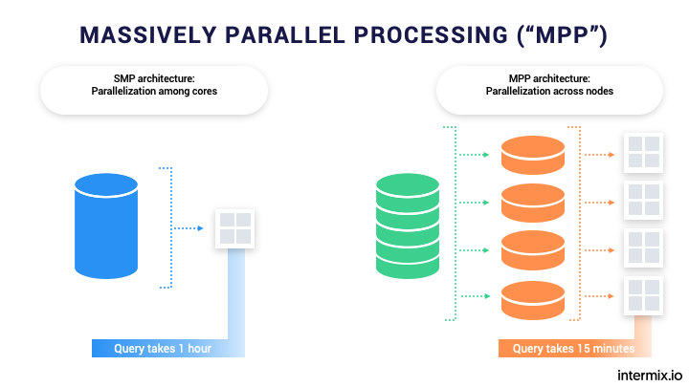
Massive Parallel Processing
Snowflake is a shared-nothing or massive parallel processing system.
Imagine if you will, for a minute, a series of workers, each of whom have their own memory, resources, and processors assigned to a task.
We can split the task among these workers thereby speeding up the task immeasurably.
“MPP is the coordinated processing of a program by multiple processors that work on different parts of the program, with each processor using its own operating system and memory”

Slide 19
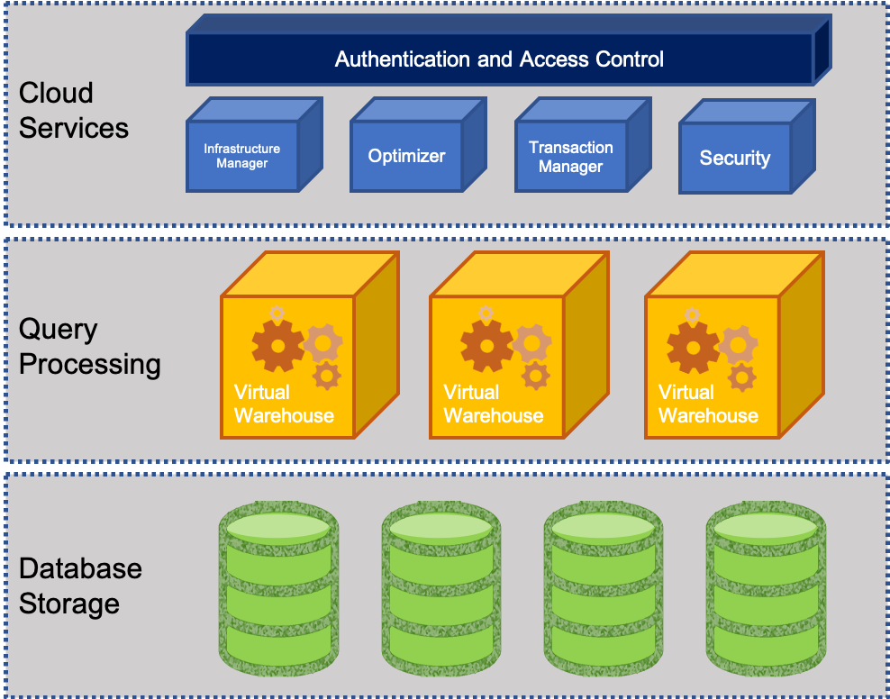
What does Snowflake offer?
Let’s divide data warehouses into three parts:
Storage: for storing data and
Computing: which is what allows us to do all the things we do in structured SQL databases
Services: Which are some of the things like pipelines, etc.
Snowflake offers us the opportunity to independently scale the storage, services, and the computing. Why is this important?

Slide 20
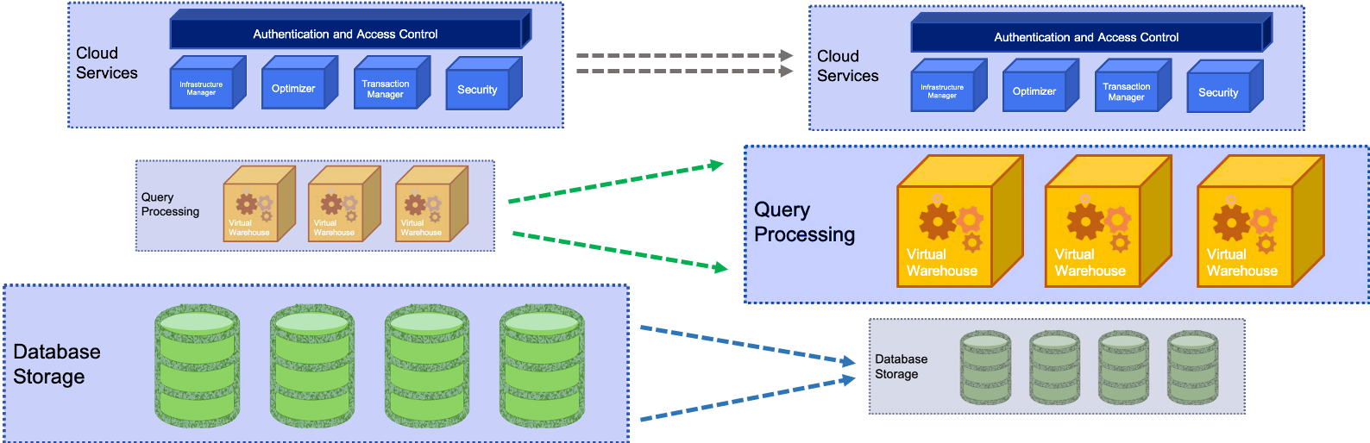
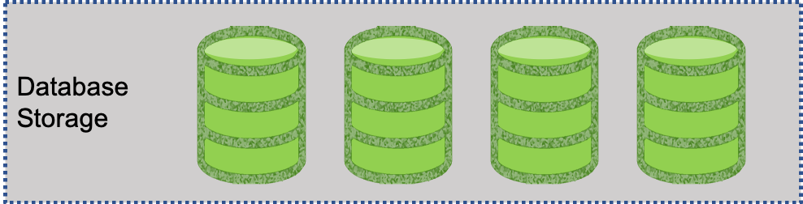
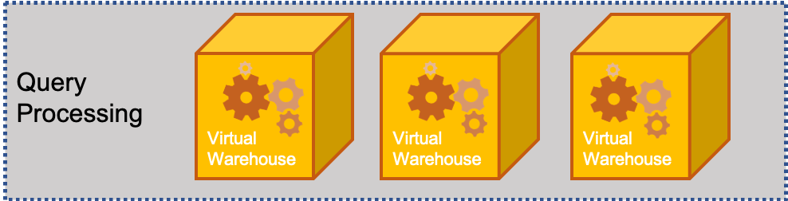
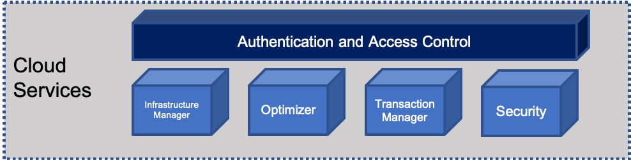
Snowflake Elasticity
Snowflake has a novel concept to deal with elasticity:
This means that we can deal with the DATA STORAGE, COMPUTE and USERS (Services) layer without effecting the other ones
DATA
Services
Compute
Notes:
By isolating each layer they can expand and contract independently of each other.
This means that we can deal with the DATA STORAGE, COMPUTE and USERS (Services) layer without effecting the other ones.
Let’s go into each of these
DATA - The amount of data stored can be increased or decreased at any time.
- Data and compute decoupled – is determined independently of the volume of data in the system
- store data at a very low cost because no compute resources are required to store data in the database
COMPUTE – these resources that are being used for query processing can also be scaled up or down depending on the intensity of the workload on the system changes.
- remember - storage and compute are decoupled,
- data is dynamically distributed
- changing compute resources does not require reshuffling the data
- Compute resources can be changed on-the-fly, without disruption.
SERVICES – with other systems as more users come on the the resources are strained and everything becomes much slower
- other system solution is to create a new datamart
- extra management burden
- replicating and/or migrating data across systems
- Snowflake can scale to support more users and workloads without performance impact because multiple virtual warehouses can be deployed on-demand, all with access to the same data.

Slide 21

Snowflake Automation
Data distribution:
Managed automatically by Snowflake based on usage.
Snowflake automatically manages how data is distributed in the virtual warehouse
Other systems rely on a static partitioning scheme based on a distribution algorithm or key chosen by the user at load time
Data is automatically redistributed based on usage to minimize data shuffling and maximize performance.
Loading Data:
Complex ETL data pipelines are no longer needed to prepare data for loading. Snowflake natively supports and optimizes diverse data, both structured and semi-structured, while making that data accessible via SQL.

Slide 22

Confused? ASK QUESTIONS

Slide 23
Break & Lab2
Notes:
Take a data set how would you set up the Schemas

